Slide 1
OpenDaylight PCMM Plugin WG Kickoff Call
Sept 14, 2015.
Notes:
Segue slide.

Slide 2
Agenda
Introductions
ODL PCMM Releases
Helium & Lithium Releases
Beryllium release plans
List of todos
------------------------------------------------------------------------------------
Open discussion
Q & A
Goals, Future Features
Contributions from the community

Slide 3
Introductions

Slide 4
List & Wiki
Mailing list :
https://lists.opendaylight.org/mailman/listinfo/packetcable-dev
Please accept the invite from the ODL mailman to confirm your subscription
Wiki :
https://wiki.opendaylight.org/view/PacketCablePCMM:Main

Slide 5
PCMM Highlevel & ODL

Slide 6
ODL PCMM Plugin Basics

Slide 7
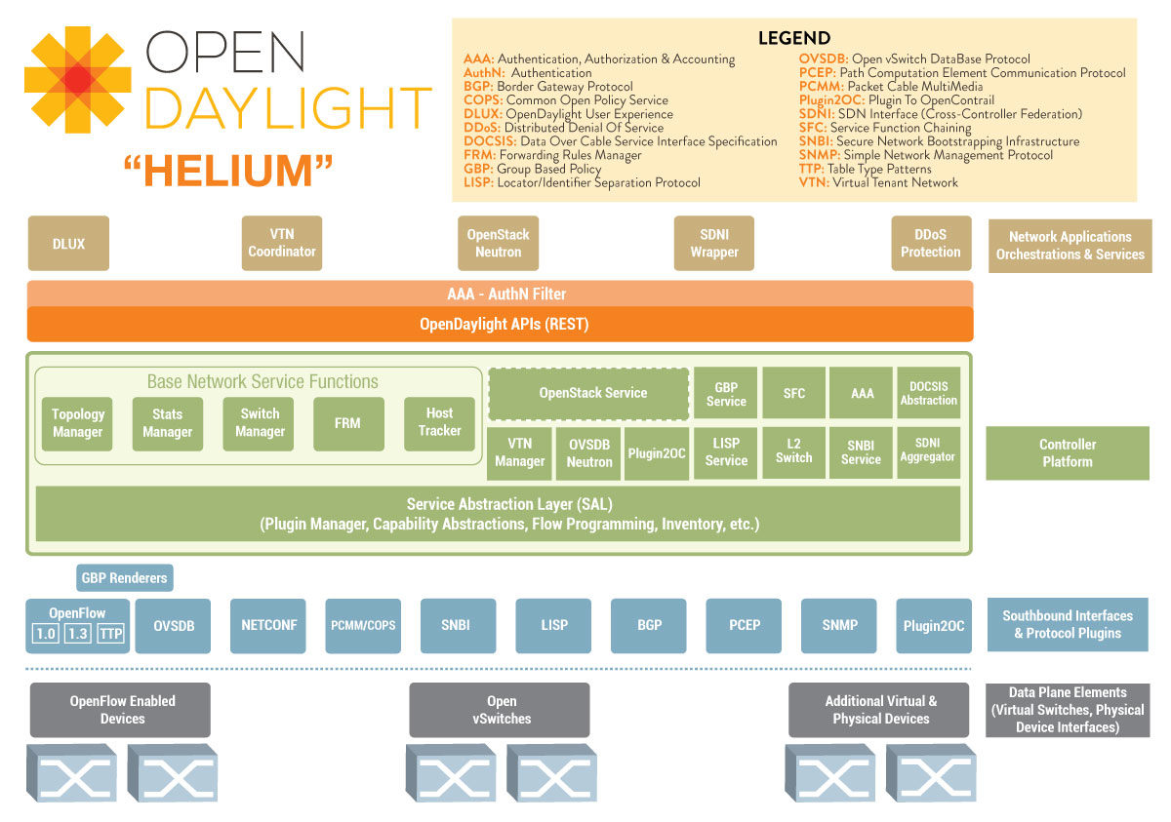
OpenDaylight : SDN Controller platform
Notes:
Open source SDN Controller
ODL community consists of 47 member companies (46 vendors + Comcast)
Only SDN controller with a Service Abstraction Layer (SAL)
Java/OSGi runtime

Slide 8
AD-SAL → MD-SAL

Slide 9
ODL Diagram Entity / packetcable ODL Module
Map between ODL Diagram Entity to ODL packetcable Modules (code repository)
ODL Diagram Entity ODL Repository Module Description
RESTCONF API
packetcable
packetcable-policy-server Processes NB RESTCONF calls, maintains socket to CCAP/CMTS
PCMM (COPS) packetcable-driver Southbound plug-in, logic for creating, configuring PCMM CCAP/CMTS
CMTS packetcable-emulator Data Plane, CMTS/CCAP emulator

Slide 10
ODL Lithium

Slide 11
ODL PCMM Release History
Hydrogen Release
PCMM Experimental code
Helium
First PCMM Release
(Sep 2014)
Initial release
AD-SAL
Lithium
Release Updates
(Jun 2015)
Migration to MD-SAL Only
New API
Vendor Contributions to API, YANG Models
Notes:
Began as a POC for SCTE 10/2013
First contributed to Open Daylight Helium (2nd) release (12/2014)
Significant updates in Lithium (3rd) release (6/2015)

Slide 12
ODL PCMM APIs & Feature support
Web Services
CRUD operations – create, read, update, delete
RESTCONF http messages (URL and Json payload)
HTTP PUTS, GETS
RESTCONF API for CMTS / CCAP
CRUD management of ODL operational data store
Supports adding multiple CMTS/CCAP

Slide 13
Example URL and Json Payload
http://{{odlHost}}:{{odlPort}}/restconf/config/packetcable:ccap/ccaps/Id-1
{ "ccaps": [{
"ccapId": "Id-1",
"amId": { "am-tag": "0xcada", "am-type": "1" },
"connection": { "ipAddress": "Ip-1", "port": “1234"},
"subscriber-subnets": [ "10.32.110.1/24" ],
"downstream-scns": [ "extrm_dn" ],
"upstream-scns": [ "extrm_up" ] }]}

Slide 14
ODL PCMM APIs & Feature support
PCMM Gates
CRUD operations for gate configuration, per subscriber
Support for Standard, Extended, and IPv6 Classifiers
Supports connection and COPS messaging to CMTS/CCAP

Slide 15
Example URL and Json Payload
http://{{odlHost}}:{{odlPort}}
/restconf/config/packetcable :qos/apps/appId-1/subs/subId-1/gates/classifier-1/
{ "gates": [{
"gateId": "classifier-1",
"gate-spec": {"dscp-tos-overwrite": "0xa0", "dscp-tos-mask": "0xff"},
"traffic-profile": {"service-class-name": "{{scnUp}}"},
"classifier": { "srcIp": “10.10.10.10", "dstIp": “10.10.10.11",
"protocol": "0", "srcPort": “1234", "dstPort": “5678",
"tos-byte": "0xa0", "tos-mask": "0xe0“ }}]}

Slide 16
Lithium Release (6/2015)
Simplified APIs
Manages QoS gates for multiple CMTSs (DSx messages)
Leverages RESTCONF APIs
Creation of CMTS Emulator for standalone testing
Code quality
Thousands of lines of code removed from Helium
Unit test coverage increased from ~3% to ~50%
Addition of basic automated integration testing
Notes:
Title and bullets layout

Slide 17
ODL PCMM Beryllium Release tasks

Slide 18
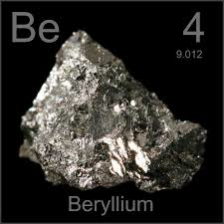
Beryllium : Goals /To Dos
Minimum updates needed to remain active in ODL
Each new release plan has new requirements
Maintenance work
Clustering (is now a new requirement for this release)
Minimum test coverage (75%)
Documentation work
Structural issues
Compliance with ODL guidelines
(e.g. be MD-SAL, YANG, RESTConf compliant)
Internal to PCMM plugin
(e.g. COPS library)
Functional Issues
Add other policy server functions
Notes:
Clustering (HA failover, concurrent, or sharded)
Continue API refactoring & development
Automated test expansion
Prioritizing other feature requests
Bug fixing

Slide 19
Beryllium : ODL Milestones
M1 & M2 – Intent to participate / Project Release Plan complete
M3 – Feature / Function Freeze: 10/15/15
M4 – API Freeze: 11/12/15
M5 – Code Freeze: 12/17/15
RC0 / RC1 / RC2: 1/7/16, 1/14/16, 1/21/16
RC3 – Release Review: 1/28/16
Formal Beryllium Release: 2/4/16

Slide 20
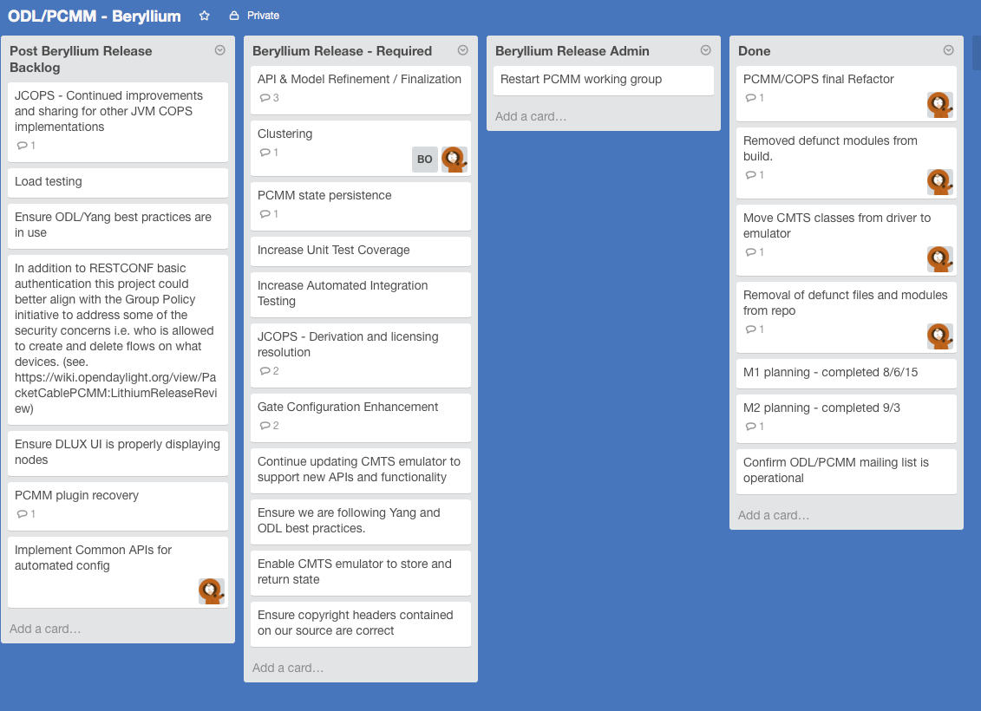
Trello board
Link: https://trello.com/b/LcLaRpwj/odl-pcmm-beryllium

Slide 21
Industry Collaboration : Call to Action
We need more reviewers: Code, YANG models, input on features, & testing
We need development resources
Need ODL Committers
We’re looking for this community to step up
Who can contribute to this effort ?
How do you want to engage ?
Plan for future releases PCMM plugin
Direction, features, & staffing

Slide 22
Roundtable Discussion

Slide 23
Open discussion
Q & A

Slide 24
Future Feature Discussion
Need input on requirements
Gap Analysis: Current ODL vs. Policy Sever
Burning needs from you ?
Notes 9/14/15
Modify the Gates once set up
Classifier set & QoS param set
Go beyond using only SCN
Modify model to store the response.
Caching Config and runtime info
Ability to store state: about gates , CMTS/CCAPs.
Losing the response data object currently ( needs a YANG model change for this)
Optimize the Keep-Alives as needed
Move away from persistent gates

Slide 25
Working Group
What are your goals for this WG?
What are your ideas for this WG?
Notes 9/14/15
How to evolve the API and then build it
API is not complete…

Slide 26
WG Logistics
Meet twice a Month till December release: Yes
Same/similar timeslot?: Yes
Notes 9/14/15
API changes need to happen sooner, so meet once a week for next 3-4 weeks and then fall to every other week

