Slide 1
OpenDaylight BGP Use-Cases
Giles Heron, Cisco
Notes:
Credit to Ed Warnicke for some of these slides

Slide 2
Agenda
Overview
Optimising Traffic using BGP-LS/PCE-P
Mitigating DDoS using BGP

Slide 3
BGP/PCE-P Overview
Notes:
Credit to Ed Warnicke for some of these slides

Slide 4

BGP/PCEP Overview
App
RESTCONF
Topology
MPLS LSPs via PCEP
PCE-P
BGP
Route Reflector
Link-State, IPv4, IPv6 and Flowspec routes
BGP
Edge
OSPF
Edge
PCE-P
OSPF
Edge
BGP
OSPF
BGP
OSPF
Core
OSPF
BGP
Edge
Core
OSPF
OSPF
Edge
PCE-P
BGP
BGP
OSPF
Route Reflector
OSPF

Slide 5
BGP Routes in ODL
LinkState: “Intra-Domain Routes”
  From ISIS or OSPF and learned via BGP-LS
  Used to create linkstate topology
Labeled Unicast: IPv4/IPv6: “Internet Routes”
  Can both learn routes and advertise them
Labeled Unicast: “Inter-Domain MPLS Routes”
  IPv4 routes with MPLS labels
FlowSpec: “Match/Action Routes”
  Like OpenFlow but using BGP - encoding actions as communites

Slide 6
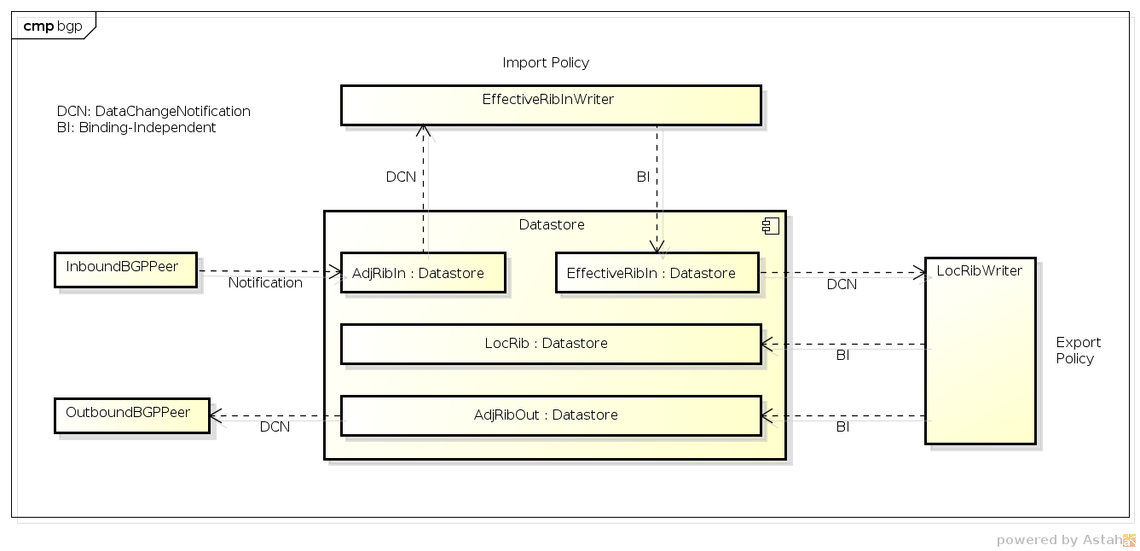
Routes – the BGP RIB (or RIBs!)

Slide 7
Topologies
BGP-LS
LinkState
IPv4
IPv6
PCE-P
OSPF
OSPF
OSPF
OSPF
OSPF
OSPF
BGP
RR
BGP
BGP

Slide 8
Use-Case:
Optimising Traffic using BGP-LS and PCE-P
Notes:
Credit to Ed Warnicke for some of these slides

Slide 9
Using BGP-LS/PCE-P for Traffic Engineering
BGP-LS enables controller to see IGP topology
  Requires one BGP-LS speaking router per IGP area
PCE-P enables controller to set MPLS LSP paths
  Across one or many IGP areas
Stateful PCE-P enables global optimisation
Killer app for this is Segment Routing
  Bandwidth allocation tracked in the controller – not in the IGP
  Use PCE-P or NETCONF/YANG to configure LSPs at ingress

Slide 10
BGP-LS Topology
PCE
RESTCONF
Topo
Bldr
Network: OSPF or IS-IS (IGP)
Routes: distributed from IGP into BGP-LS
RIB: Learned from BGP-LS speaker
Topology: Lists of nodes (routers) and links
RESTCONF URL:
http://localhost:8181/
restconf/operational/
network-topology:network-topology/topology/
example-linkstate-topology
BGP-LS
BGP-LS
OSPF
OSPF
OSPF
OSPF
OSPF
OSPF

Slide 11
PCE-P Topology
PCE
RESTCONF
Node LSPs
x ..,..,..
y ..,..,..
z ..,..,..
List of all PCCs (Path Computation Clients)
For each PCC, list of LSPs for
which it is the ingress LSR
Topology: Created by PCE-P plugin
  RESTCONF URL:
  http://localhost:8181/
  restconf/operational/
  network-topology:network-topology/
  topology/pcep-topology
PCE-P
LSPs
BGP-LS
PCE-P
MPLS
MPLS
PCE-P
PCE-P
MPLS
MPLS
MPLS
MPLS

Slide 12
PCE-P LSPs (dynamic)
PCE
RESTCONF
Node LSPs
x ..,..,..
y ..,..,..
z ..,..,..
PCE creates MPLS-TE Label Switched Paths on PCC
Can modify LSP after setup or delete LSP
PCE-P
LSPs
BGP-LS
  RESTCONF URL:
http://localhost:8181/
restconf/operations/
network-topology-pcep:add-lsp
(update-lsp / remove-lsp)
PCE-P
MPLS
MPLS
PCE-P
PCE-P
MPLS
MPLS
MPLS
MPLS

Slide 13
PCE-P LSPs (delegated)
PCE
RESTCONF
Node LSPs
x ..,..,..
y ..,..,..
z ..,..,..
PCC delegates locally configured MPLS-TE LSP to PCE for path selection:
Use update-lsp RPC to set path
PCE-P
interface tunnel-te1
ipv4 unnumbered Loopback0
signalled-name foo
!
destination 192.168.100.4
pce
delegation
LSPs
BGP-LS
PCE-P
MPLS
MPLS
PCE-P
PCE-P
MPLS
MPLS
MPLS
MPLS

Slide 14
Demo:
BGP-LS/PCE-P & SR
Notes:
Credit to Ed Warnicke for some of these slides

Slide 15
Use-Case:
DDoS Mitigation
Notes:
Credit to Ed Warnicke for some of these slides

Slide 16
Advertising BGP Routes
(Application RIB)
App
RESTCONF
IPv4/IPv6 Routes: inter-domain routes
FlowSpec Routes: packet filters
APP RIB is config (main RIB is operational)
  APP RIB is a special-case peer of the main RIB
  (like iBGP but routes are sent to iBGP peers)
BGP RIB
App RIB
BGP
BGP
OSPF
BGP
OSPF
OSPF
OSPF
OSPF
OSPF
OSPF

Slide 17
Setting “Flows” (FlowSpec)
RFC5575 - Similar to OpenFlow but uses BGP to distribute match/action rules
Matches:
Source / Destination IP prefix
IP Protocol
Source / Destination TCP/UDP port
ICMP Type / Code
TCP Flags
Packet Length
DSCP Field
Fragment (DF, IsF, FF, LF)
Actions:
Rate limit
Traffic sampling
Redirection
Traffic marking (DSCP)
And more... (optional)

Slide 18
DDoS Mitigation using uRPF and IPv4/IPv6
App
192.168.101.1/32 -> 192.0.2.1
RESTCONF
point 192.0.2.1/32 to null on all nodes
turn on uRPF
Advertise routes with next-hop of 192.0.2.1 to discard.
BGP RIB
App RIB
BGP
BGP
OSPF
192.168.101.1/32
192.0.2.1/32->null0
192.168.103.1/32

Slide 19
Demo
Advertising IPv4 Routes
Notes:
Credit to Ed Warnicke for some of these slides

Slide 20
Thank you

