Slide 1
Dynamic Resource Reservation
Project Proposal
April 10th 2014
Presented by : Mathieu Lemay

Slide 2
Contents
Background, Motivation & Scope
  Background
  Motivation
  Scope
Draft Specifications
  Goal
  Use Cases
  Architecture
  API / Interfaces
Project Management
  Members
  Roadmap

Slide 3
Background, Motivation & Scope
Background (R&E Networks)
  Europe (Phosphorus, IDC)
  US (OSCARS)
  Japan (G-Lambda)
Motivation
  Networking as a Service
  Bandwidth on demand
  End to End Networking
Scope
  Reservation & Scheduling
  Multi-layer PathFinding
  Physical & Virtual

Slide 4
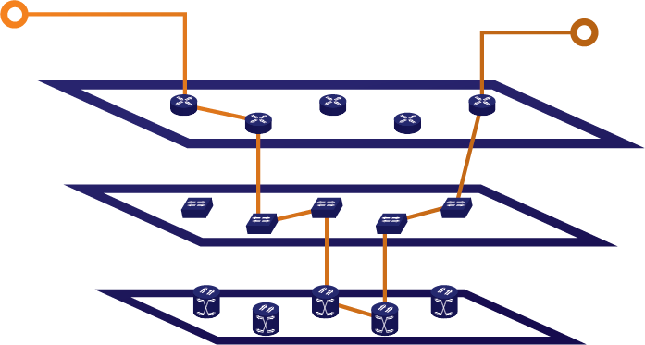
Draft Specification
End to end Multi-layer provisioning
Link Information
Latency
Bandwidth
Endpoints

Slide 5
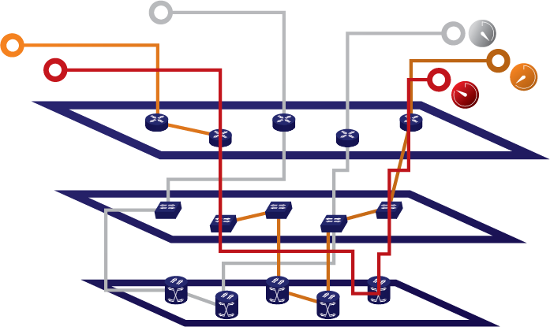
Draft Specification
Dynamic Resource Reservation
Link Information
Latency
Bandwidth
Endpoints
Start Time
Duration

Slide 6
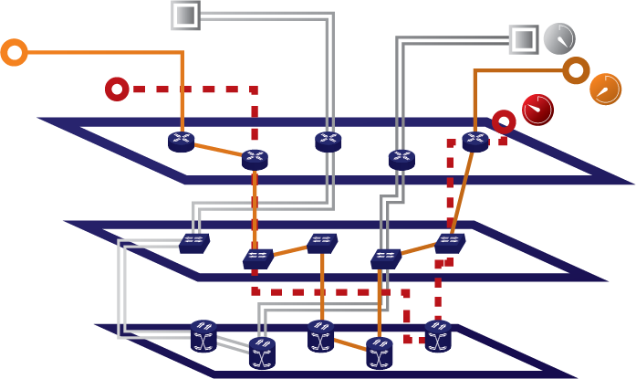
Draft Specification
Generic Dynamic Resource Reservation
Link Information
Latency
Bandwidth
Endpoints
Start Time
Duration
Other Attributes (cost, etc.)

Slide 7
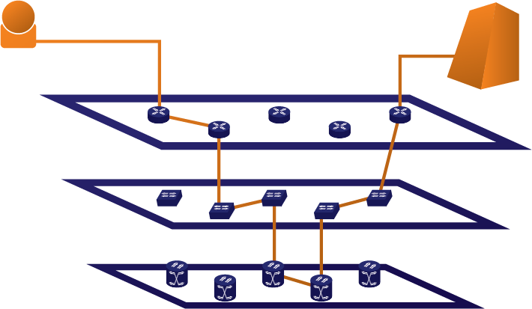
Draft Specification
Use Case #1 – Cloud Access
In Cloud Access Scenario the user will use the service to get dynamic access to cloud

Slide 8
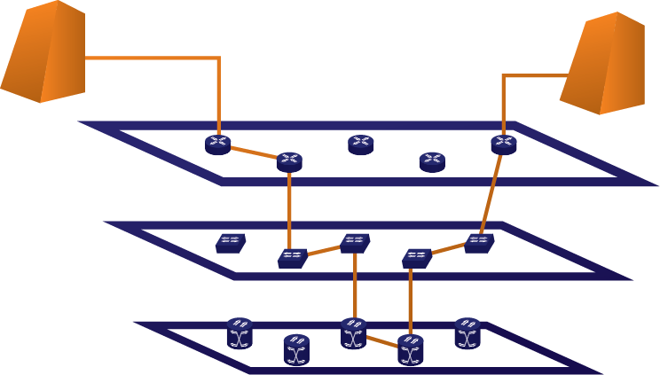
Draft Specification
Use Case #2 – Inter DataCenter Access
For Inter Datacenter scenario big pipes can be established between sites for Virtual Datacenter data mobility.

Slide 9
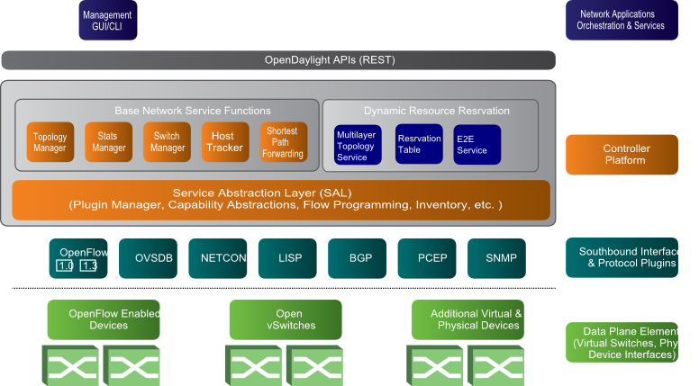
Draft Specification
Architecture

Slide 10
Draft Specification
API / Interfaces
Potential Northbound Standards
  OGF NSIv1
  OGF NSIv2
Other Standards possible
Any thoughts?

Slide 11

Project Management
Members
Anyone welcome to join…

Slide 12
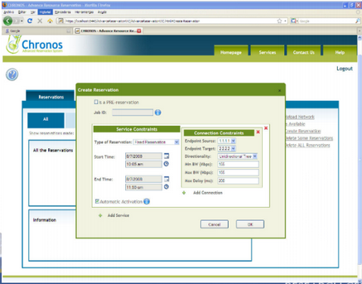
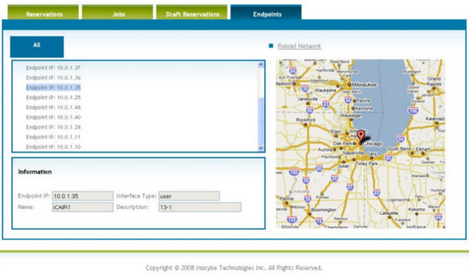
Project Management
On legacy expertise
Legacy NaaS Product
Experience
Automated GOLE/ HPDMnet NREN Projects
Projects
Anyone welcome to join…

Slide 13
Project Management
Roadmap
Initial Prototype
E2E Provisioning
Scheduling
General Availability
Timeline to be determined after controller changes

